Slide 1


WEEKEND
MEAL
SERVICE
FOR SATURDAY PROGRAM STAFF

Slide 2


OVerview
This training will detail the following procedures:
Saturday Breakfast and Lunch services
Saturday Supper Field trips
Sunday Supper Field trips

Slide 3

CDE APPROVED
Saturday breakfast and lunch meals are mandated services pre-approved by the CDE for all main sites and off-sites.
Implementation can begin once the Request to Begin or Change Saturday Meal Service is completed and approved by the Food Services Division

Slide 4

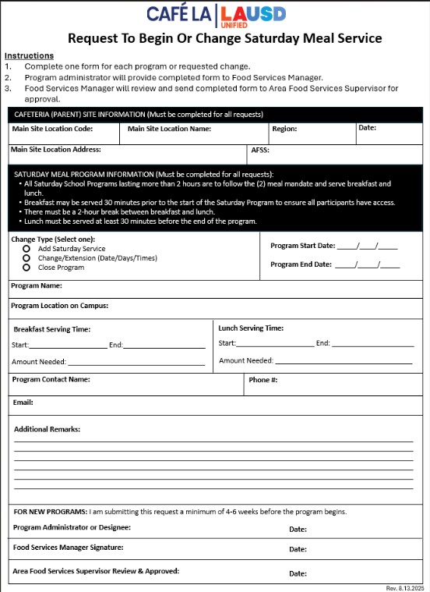
REQUEST TO BEGIN OR CHANGE SATURDAY MEAL SERVICE
Saturday Program Staff must inform the Food Service Manager (FSM) of any new Saturday Program beginning on campus 4-6 weeks before the program start date:
Once completed by the program administrator, form must be signed by the FSM and Area Food Services Supervisor (AFSS) for approval.

Slide 5
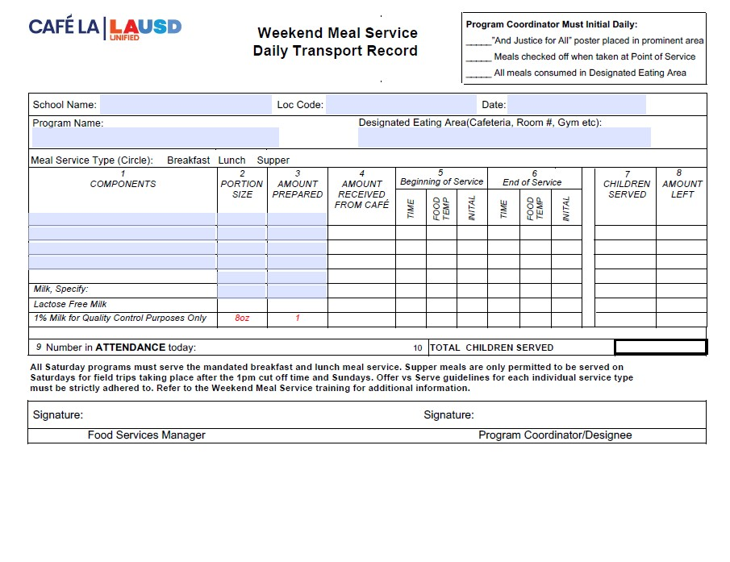
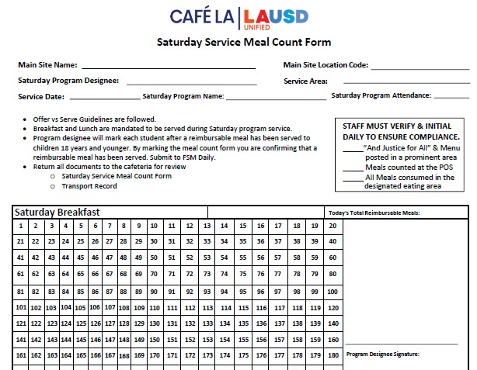
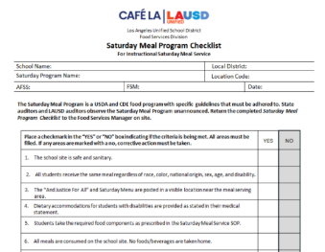

Saturday
Breakfast
&
Lunch Required Forms
1
2
Weekend Meal Service Daily Transport Record
Completed Daily
Saturday Meal Count Form
Completed Daily
3
Saturday Meal Service Checklist
Completed within
first 4 months of program

Slide 6

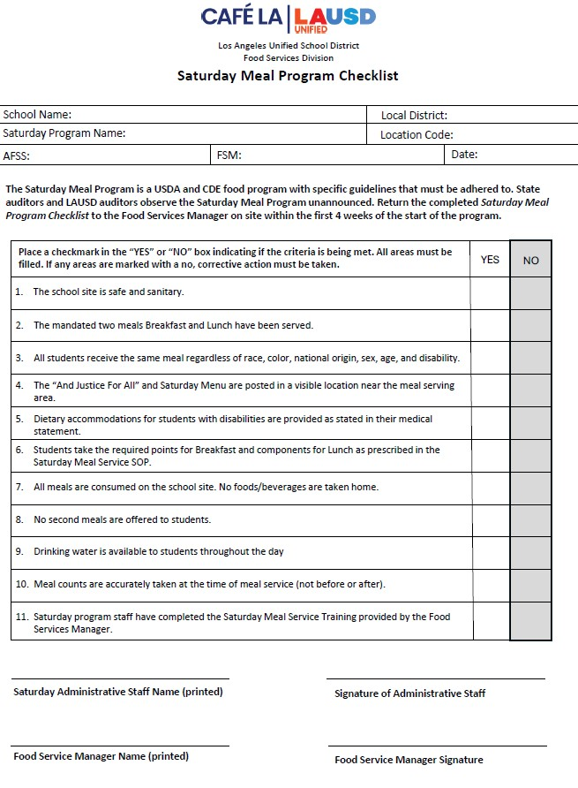

Saturday Meal Service Checklist
The Saturday Meal Service Checklist is for all Saturday School programs.
Check list must be completed within the first 4 weeks of the Saturday program by the Saturday program administration
This ensures all Saturday programs are in CDE compliance

Slide 7
WEEKEND DAILY TRANSPORT RECORD
Daily transport records are used whenever food is being served outside of FSD hands.
FSM will pre-fill the header with school name, location code, date, ect.

Slide 8
WEEKEND DAILY TRANSPORT RECORD
Daily transport records are used whenever food is being served outside of FSD hands.
FSM will then pre-fill all components, portion sizes, the amount prepared and circle the meal service being served .

Slide 9
WEEKEND DAILY TRANSPORT RECORD
Daily transport records are used whenever food is being served outside of FSD hands.
Once received from the cafeteria Program staff will fill in amounts for:
Amount received
Time and Temperature of each food item at the beginning and end of service. Initialing each item
Children served
Amount leftover

Slide 10
WEEKEND DAILY TRANSPORT RECORD
Daily transport records are used whenever food is being served outside of FSD hands.
At the end of service, Saturday Program Staff will record the total attendance and total children served reimbursable meals

Slide 11
WEEKEND DAILY TRANSPORT RECORD
Daily transport records are used whenever food is being served outside of FSD hands.
Before returning the Weekend Meal Service Daily Transport Record, Saturday program staff will sign. Verifying all information is true and correct.

Slide 12
WEEKEND DAILY TRANSPORT RECORD
Daily transport records are used whenever food is being served outside of FSD hands.
FSM will sign once the transport record is completed and returned, signifying the information is true and correct.

Slide 13
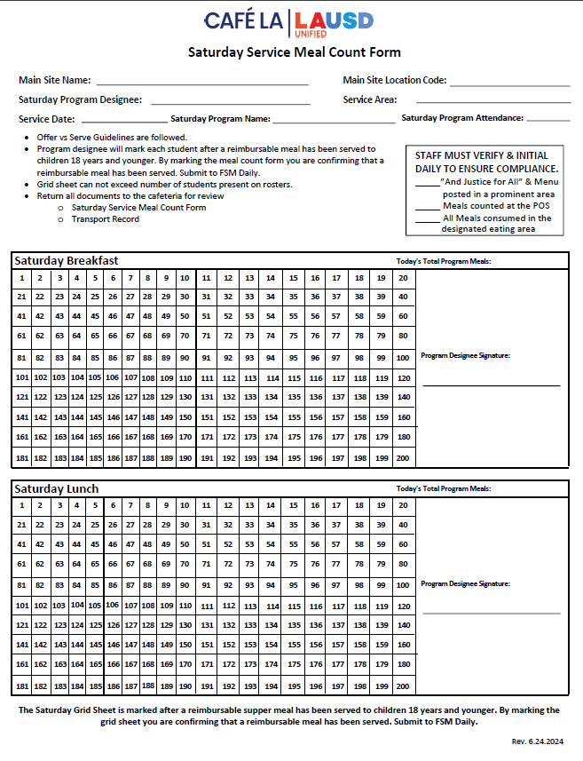

SATURDAY
SERVICE MEAL COUNT FORM
The Saturday Service Meal Count Form will be used for Saturday breakfast and lunch only.
Saturday field trips that take place before the 1pm cut off time will serve the mandated breakfast and lunch in accordance with CDE guidelines

Slide 14
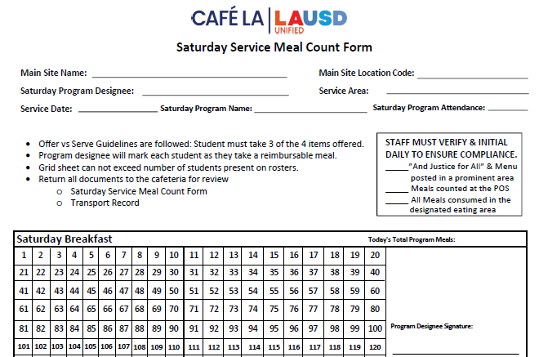
SATURDAY SERVICE MEAL COUNT REPORT
continued
FSM will complete the header portion for:
Main site name
Main site location

Slide 15
SATURDAY SERVICE MEAL COUNT REPORT
continued
Program staff will complete the remaining portions of header. Including initialing the daily compliance box in the right-hand corner of the form.

Slide 16
SATURDAY SERVICE MEAL COUNT REPORT
continued
Program Staff will then mark off each student as they receive a reimbursable meal on the grid portion of the form.

Slide 17
SATURDAY SERVICE MEAL COUNT REPORT
continued
Number of reimbursable meals served must not exceed the amount of attendance.

Slide 18
SATURDAY SERVICE MEAL COUNT REPORT
continued
Once service has ended. Program Staff will sign verifying all information is true and correct.

Slide 19
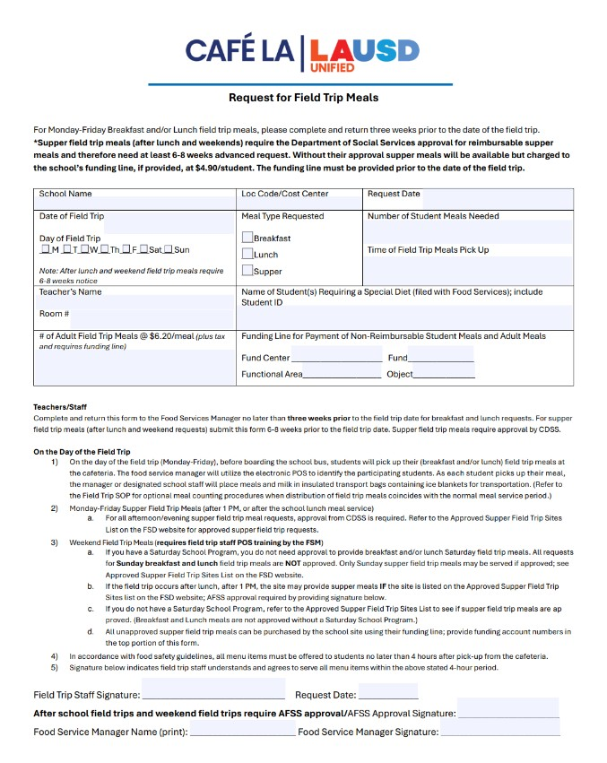
WEEKEND FIELD TRIPS
When requesting Saturday or Sunday field trips, program staff are required to complete the Request for Field Trip Meals form 3 weeks prior to the field trips date.

Slide 20
WEEKEND FIELD TRIPS
If you do NOT have a Saturday School Program you will require the Food Service Division AFSS’s approval to serve Saturday or Sunday field trip meals.

Slide 21
WEEKEND FIELD TRIPS
*Schools with an already approved Saturday Program are pre-approved for field trip meals. However, the Request For Field Trip Meals form is still required to notify managers of serving amounts and planning purposes*

Slide 22
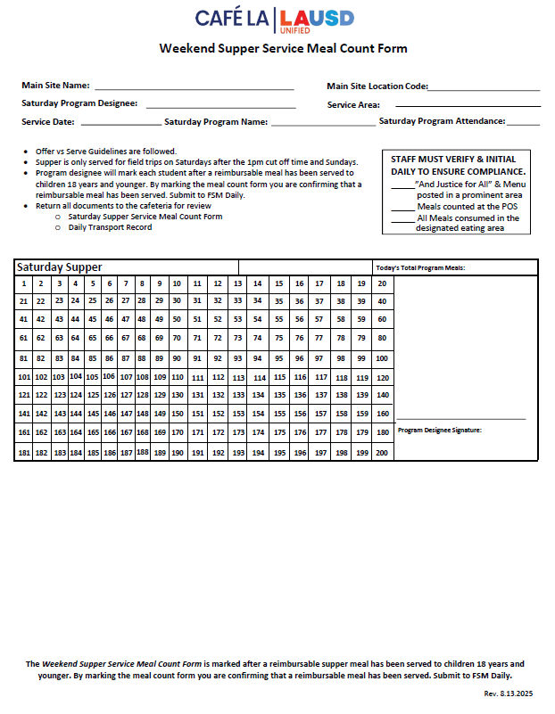
WEEKEND SUPPER SERVICE MEAL COUNT FORM
The Weekend Supper Service Meal Count Form is required for all:
Saturday field trips that take place after the 1pm cut off time
Sunday field trips requiring a meal

Slide 23
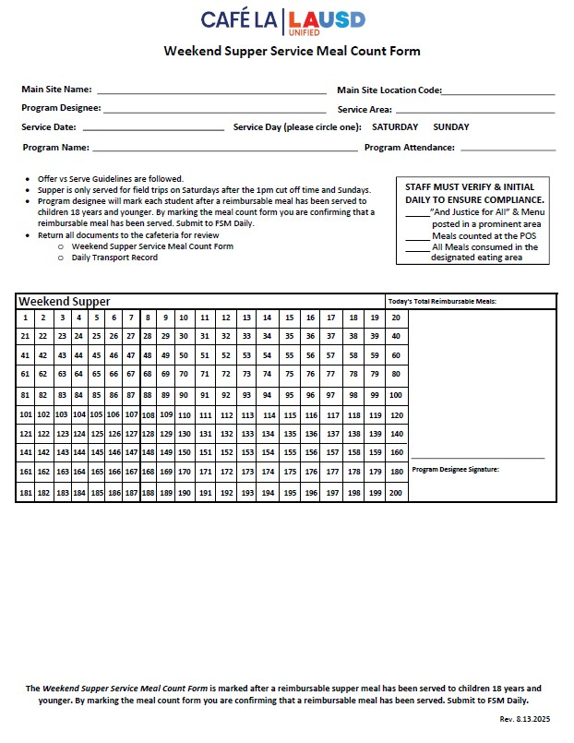
WEEKEND SUPPER MEAL COUNT FORM
FSM will fill in the Main site and main site location before leaving the form for program staff.

Slide 24
WEEKEND SUPPER MEAL COUNT FORM
Program staff must ensure the service date is entered and the service day has been circled, along with all other header information.

Slide 25
WEEKEND SUPPER MEAL COUNT FORM
Program staff will then mark each student as they receive a reimbursable meal, enter the total amount of reimbursable meals and sign.

Slide 26
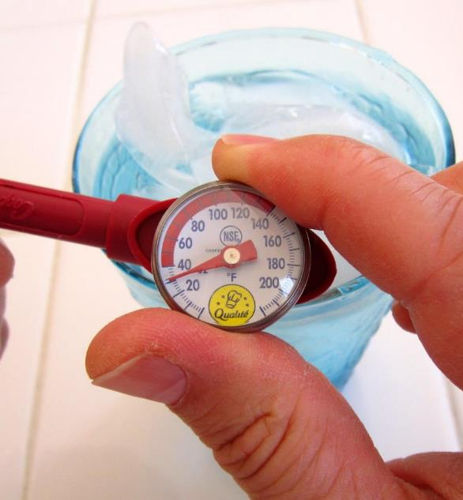
HACCP Guidelines
Saturday Program Staff are required to follow all HACCP guidelines.
Food Service Manager will leave Weekend Meal Service Menu items in an accessible refrigerator unit for Saturday program staff.
Three(3) clean, sanitized, and calibrated thermometers will be provided by the Food Services Manager to Saturday Program Staff along with sanitation wipes.
ALL potentially hazardous items, hot and cold, must be temped and recorded onto the Daily Transport Record.
The Food Service Manager will add one carton of milk for temperature-taking purposes. Discard milk afterwards.

Slide 27





HACCP Guidelines
continued
When temping pre-packaged items such as packaged fruits and vegetables:
38
Sandwich the thermometer between two pre-packaged items to temp
Do not puncture the bag of the pre-packaged item.
This can be done with all pre-packaged items such as carrots, apple slices, celery and so forth.
Cold items must temp 41 and below

Slide 28





HACCP Guidelines
continued
When temping items like packaged sandwiches or coffee cake:
38
Do NOT open packaging.
Puncture a hole into the packaging to temp food item inside.
Once temped the food item is still safe for consumption.

Slide 29









OFFER VS SERVE
In an effort to reduce waste all instructional Saturday programs will follow Offer vs Serve guidelines for all meal services:
Saturday Breakfast
Student must take 3 or more points; one must be a fruit.
Saturday Lunch
Student must take 3 components
One component MUST be a fruit or vegetable.

Slide 30
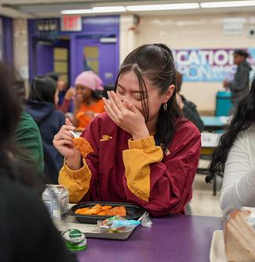
Saturday Breakfast Service

Slide 31














Each food item will account for a
certain amount of points
One food item must be a
Fruit Juice or Whole Fruit
Main food item’s are worth
2 Points
Breakfast is now based on a
points system.
Students must take a total of
3 points
All other food items are worth
1 point
=
Fruit Juice
Deluxe Cereal Bowl
Deluxe Cereal Bowl
Yogurt & Crackers
Milk
Fruit Juice
Whole Fruit
1 point
1 points
2 points
2 points
3 points
1 point
1 point
2 points

Slide 32
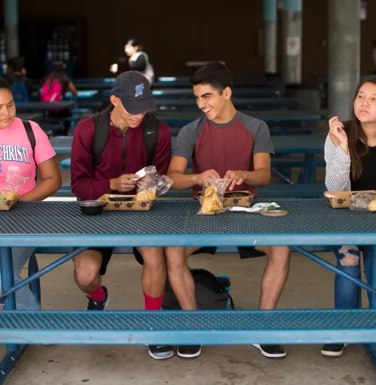
Saturday Lunch Service

Slide 33





Only 3 out of the 5 Components must be taken to make a reimbursable meal.
A Fruit or Vegetable must always be taken!
Lunch is based off of 5 meal Components
Meat/ Meat Alternate
and Grains
Milk is optional
And Milk
Fruits and Vegetables
Sunbutter & Jelly Sandwich
Celery
Celery
Sunbutter & Jelly Sandwich
Celery
Apples
Milk
Apples
Milk
Meat/ Meat Alternate / Grain
Vegetable
Vegetable
Meat/ Meat Alternate / Grain
Vegetable
Fruits
Milk
Fruits
Milk

Slide 34
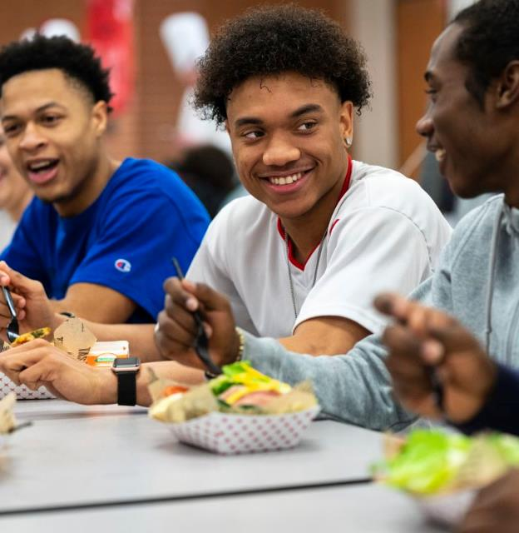
Saturday Service Overview

Slide 35






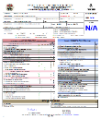


FSM will leave meals for Weekend Service in a refrigeration unit easily accessible to Program staff

Slide 36

The Next Day
Program staff will pick up the meals in the designated refrigeration unit.

Slide 37
After Service
It is important to always return the meals back to the designated refrigeration unit.
Program Staff will return unserved/unused meals to the designated refrigeration unit

Slide 38












`
The Following Monday
Managers will return unused food items back to stock
Its important we all do our part to eliminate waste
But they can’t if everything has spoiled

Slide 39

Together we can keep waste down and continue to feed our students healthy nutritious meals!

Slide 40









And don’t forget to leave all paperwork in the bags provided! I’ll be entering all information in CMS the Monday we return.
Queen Bee designs

Slide 41
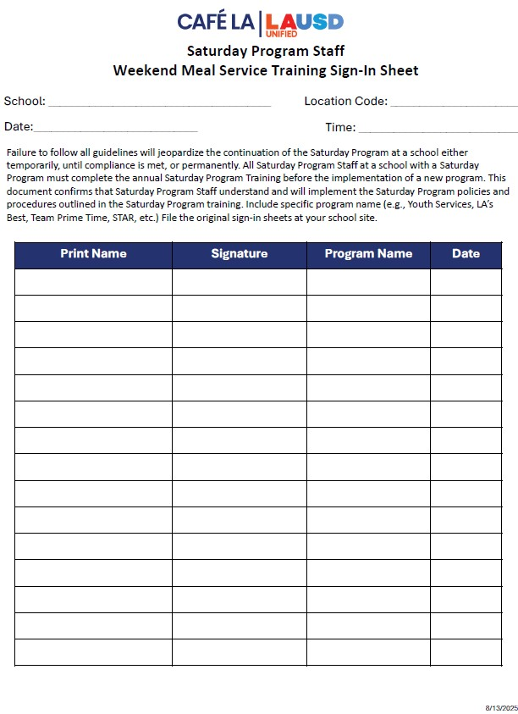
Saturday Program Training Verification Forms
FSD is required to provide annual Saturday Program training to Food Service Managers and Saturday Program staff before the implementation of a new program.
Program staff will sign the Saturday Program Training Sign-in sheet located on the Principal Resources page after the completion of this training then return the signed form to the FSM.

Slide 42
Summary
To recap this training has covered:
Program Rules.
Saturday Productions
Saturday Grid Sheets.
Identifying Reimbursable Meals.
Saturday Meal Service Compliant Checklist
CMS accountability

